Slide 1
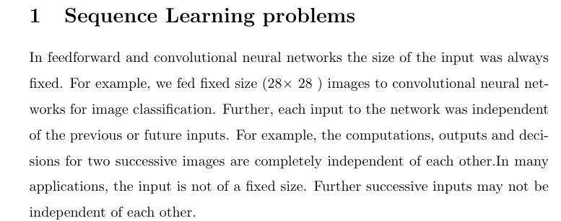
RNN, LSTM and GRU

Slide 2
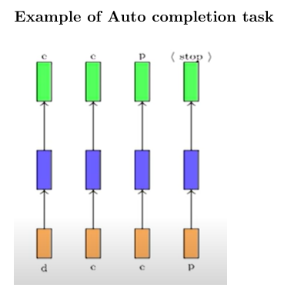
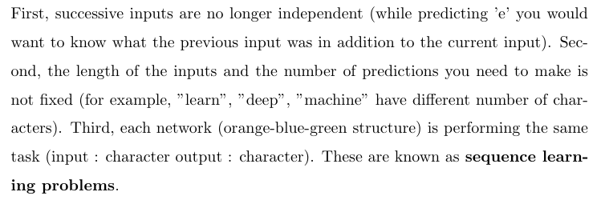


Slide 3
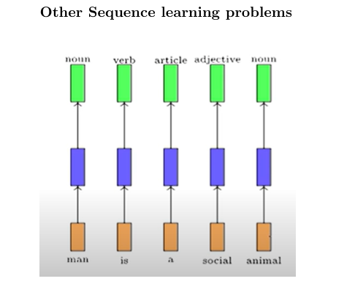
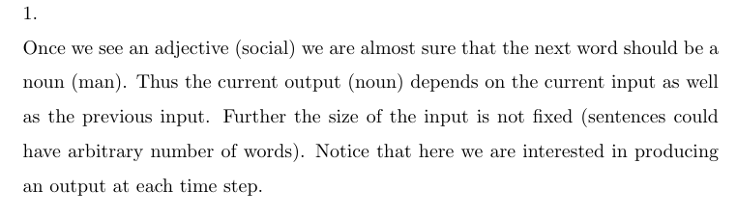

Slide 4
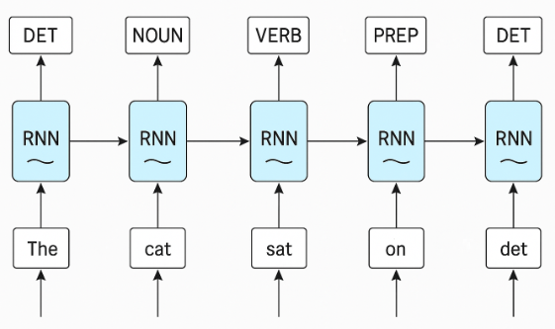
Once the article The comes then we expect a noun usually then we expect a verb after that so the POS tagging happens with previous word information as well. So RNN is one best choice in POS tagging

Slide 5
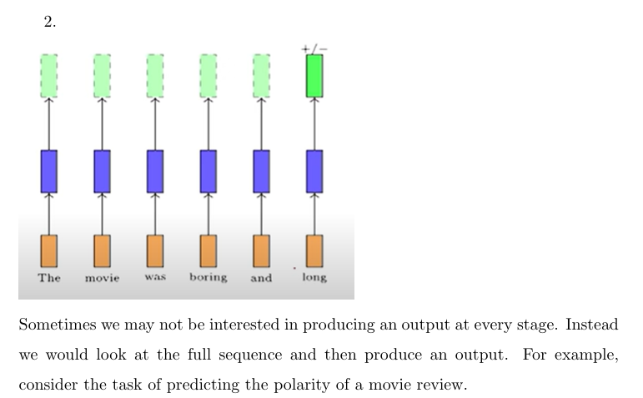

Slide 6
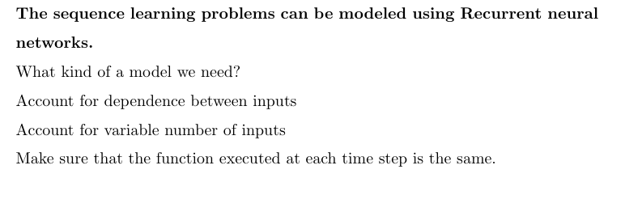
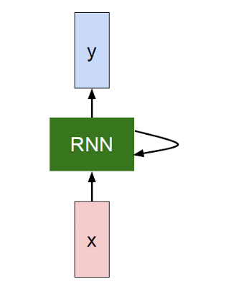

Check Code

Slide 7
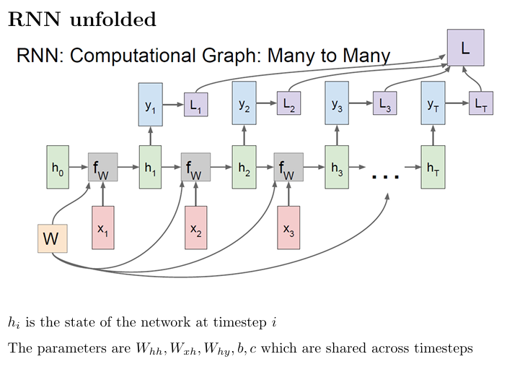

Slide 8
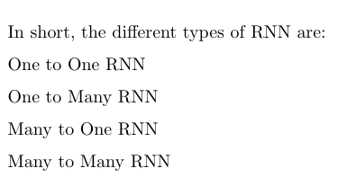
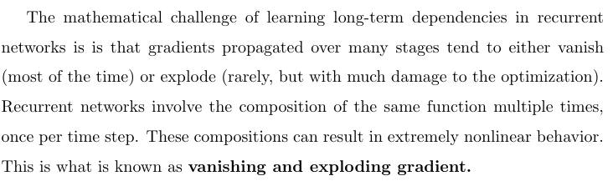
The challenge of long-term dependencies in RNN

Slide 9
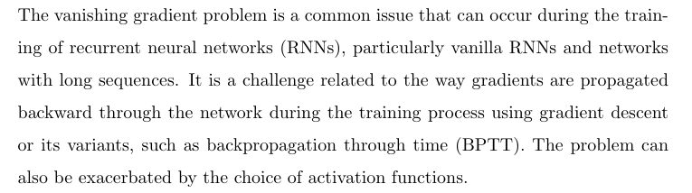
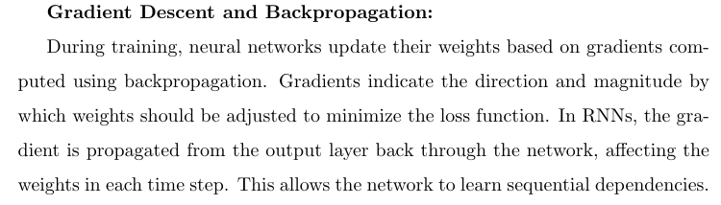

Slide 10
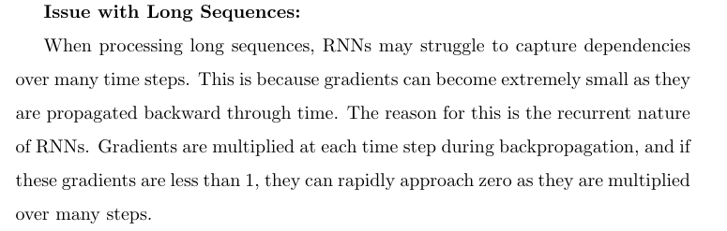
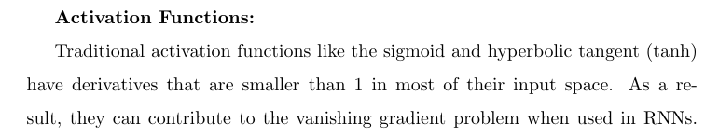

Slide 11
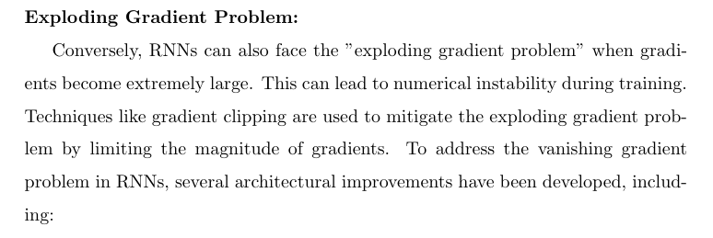
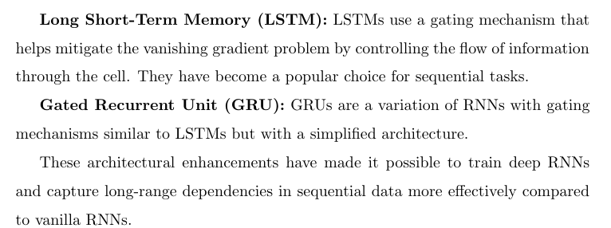

Slide 12

Example where RNN does this: Sentiment analysis: Predicting movie review where it reads the complete paragraph by the reviewer and outputs a sentiment. We are only interested in the important words not the stop words. Which are of no importance.
How LSTM takes care of the situation.
While RNN moves from we must have the selective read, write and forget operation to be happening
$$h_{t−1}→ h_{t}$$

Slide 13
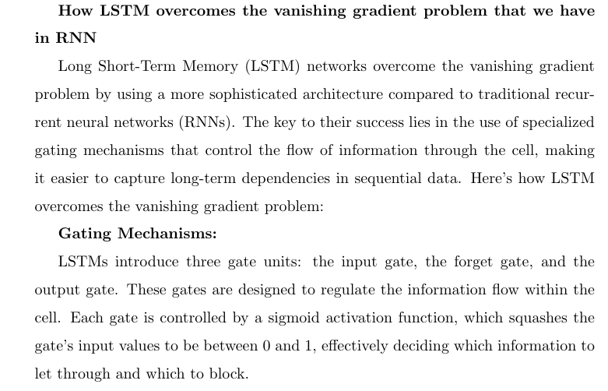

Slide 14
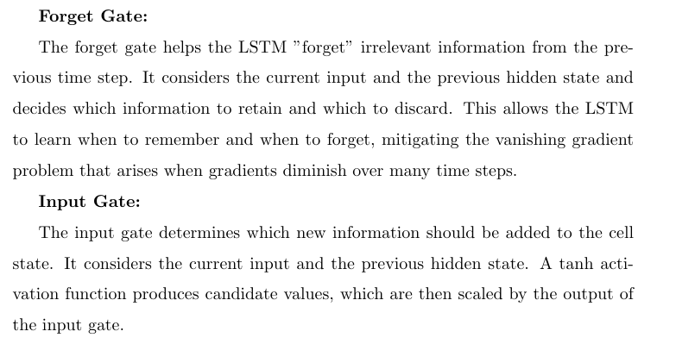

Slide 15
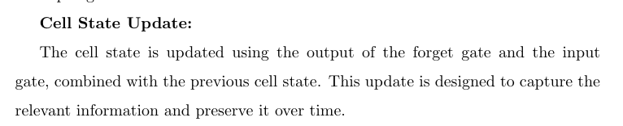

Slide 16
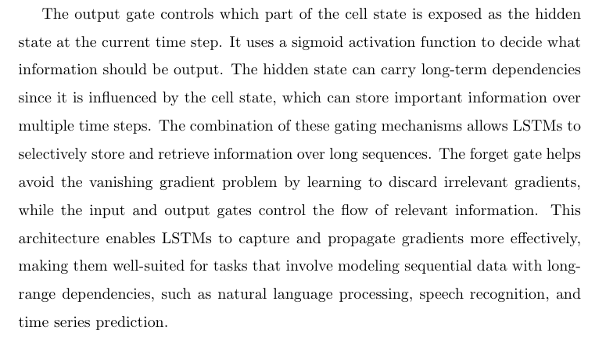
Output Gate

Slide 17
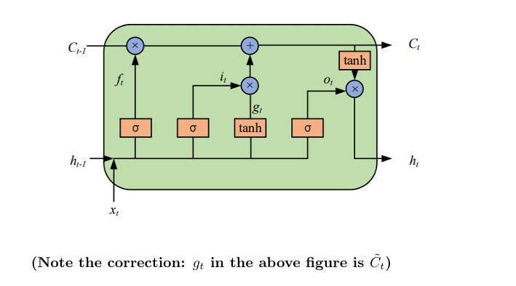

Slide 18
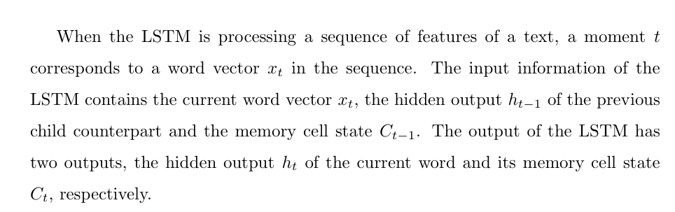

Slide 19
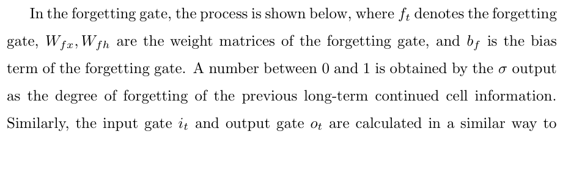
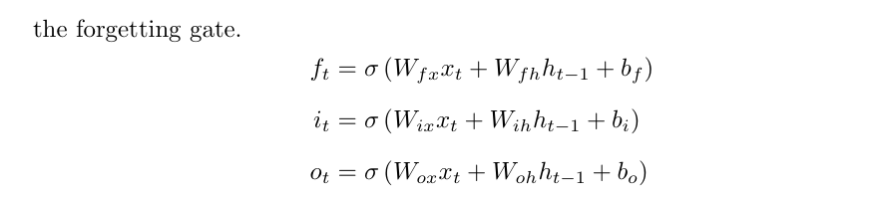

Selective write is at o_{t} So,

Slide 20


Selective read is at i_{t} So,

Slide 21

Selective forget is at f_{t} So,

Slide 22

Selective read is at i_{t} So,
Current memory cell state,

Slide 23
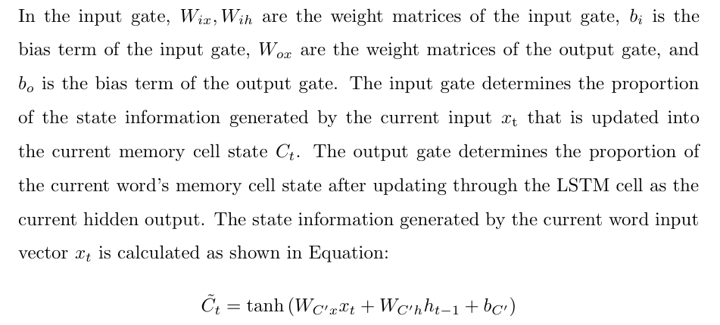
LSTM- Explanations

Slide 24
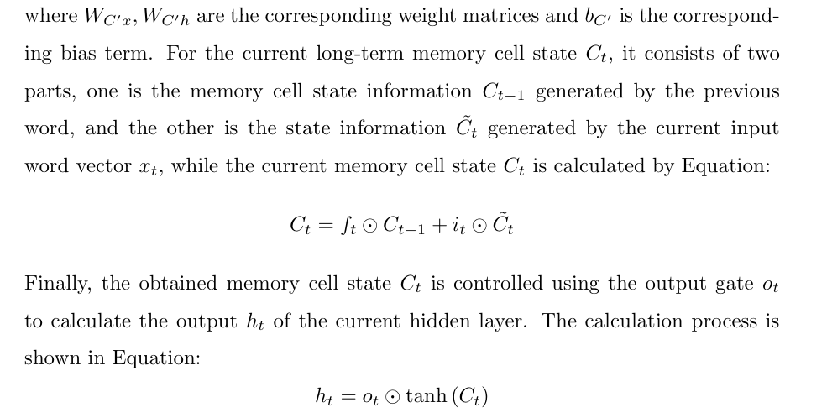
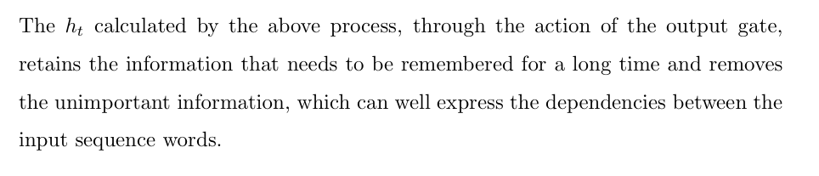

Slide 25
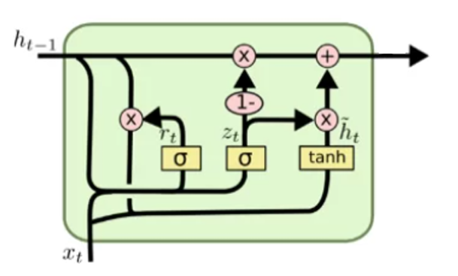


GRU
Update gate $z_{t}$→ decides how much of the previous hidden state to keep.
Reset gate $r_{t}$→ decides how much of the past information to forget/reset.

Slide 26


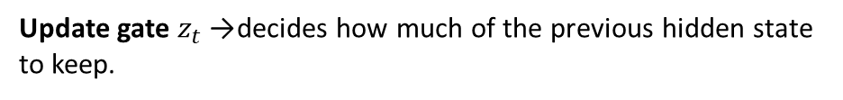
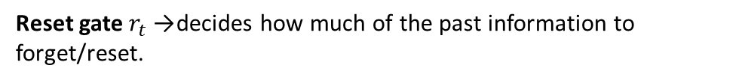
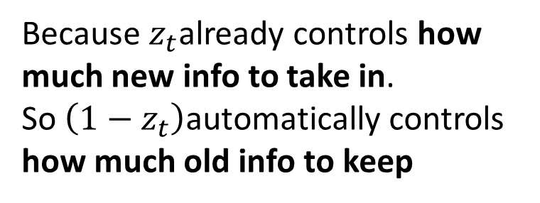
GRU
Update gate $z_{t}$→ decides how much of the previous hidden state to keep.
Reset gate $r_{t}$→ decides how much of the past information to forget/reset.
weighted average (interpolation) between past and new info.
Candidate state:
Because $z_{t}$already controls how much new info to take in. So $\left(1−z_{t}\right)$automatically controls how much old info to keep

Slide 27
GRU
Long sequences with complex dependencies → LSTM
Shorter sequences, smaller datasets, or speed is important → GRU
weighted average (interpolation) between past and new info.
Candidate state:
Because $z_{t}$already controls how much new info to take in. So $\left(1−z_{t}\right)$automatically controls how much old info to keep

Slide 28
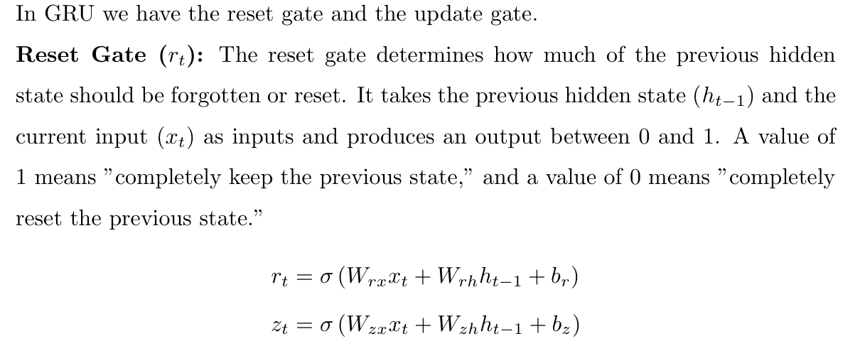
GRU - Explanations

Slide 29
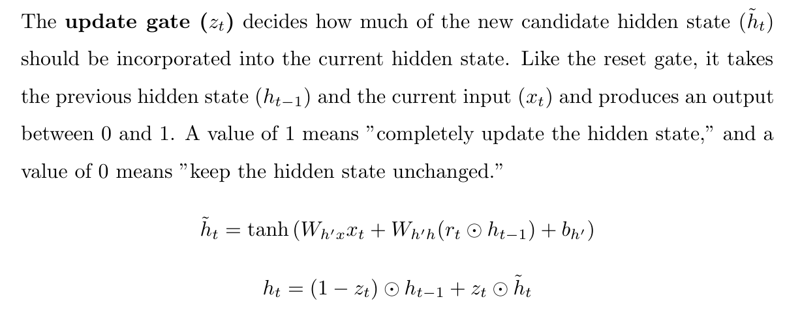
GRU
Long sequences with complex dependencies → LSTM
Shorter sequences, smaller datasets, or speed is important → GRU

Slide 30
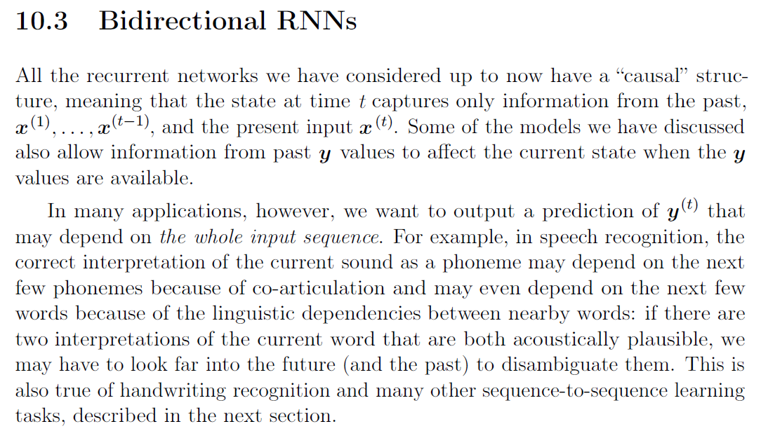

Slide 31
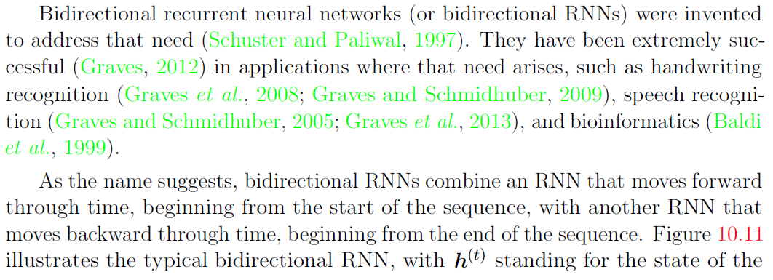
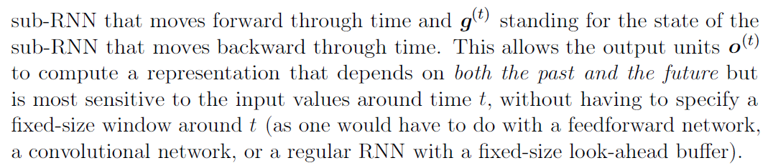

Slide 32

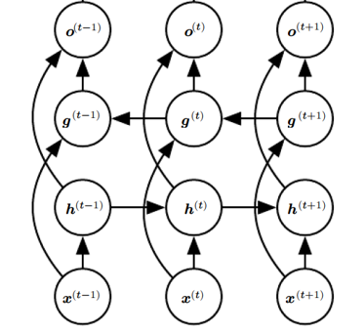
Consider the sentence: "I like apple. It is very healthy.“
In a traditional unidirectional RNN the network might struggle to understand whether "apple" refers to the fruit or the company based on the first sentence. However, a BRNN would have no such issue. By processing the sentence in both directions, it can easily understand that "apple" refers to the fruit, thanks to the future context provided by the second sentence ("It is very healthy."). Bi-LSTMs
Used in NER, POS and Machine translation

